Slide 1
Project idea OWE4SC
Open Wise Edge for Smart Communities
ITEA PO Preparation Days 2018
Daniel Pakkala, VTT

Slide 2
Introduction
In our daily life (leisure and work) everything is currently under digitalization. New kind of interaction, value co-creation and innovations are possible by developing on-demand digital services aggregating and analyzing data from multiple sources.
  Artificial Intelligence (AI) and Edge Computing are enabling new capabilities for digital services, including near real-time automated and fine-grained sensing-analysis-actuation loops, better response time, locality with enhanced safety and privacy.
Application domains such as Health & Wellness, Smart Energy and Smart Buildings will benefit from the AI and edge computing enabled capabilities of digital services.
  The project will focus in collaborative R&D of Open Wise Edge (OWE) technology platform and ecosystem unleashing the capabilities of AI, edge computing, open source, open data and open models for holistic optimization and innovation of new digital services for smart consumer and professional communities.

Slide 3
Market relevance, innovation and business impact
What is the market relevance?
Growing markets of digital services (value co-creation)
AI applications (value from data in use)
Edge computing markets
What is the innovation?
Co-creation and co-innovation of AI and Edge Computing based digital services/service features in Health & Wellness, Smart Energy and Smart Building application domains
Holistic optimization of behavior/operations/processes via AI and Edge Computing based digital services
Open Wise Edge (OWE) technology platform and ecosystem (Open Source, Open Data, Open Models)
What is the business impact?
Open technology platform for digital services development with AI and Edge Capabilities (especially SMEs will benefit)
Open application, model and data markets for AI and Edge computing based digital services innovation
Increasing competitiveness, finding partners and creating cost savings via introduction of AI and Edge based digital services for consumers and businesses

Slide 4
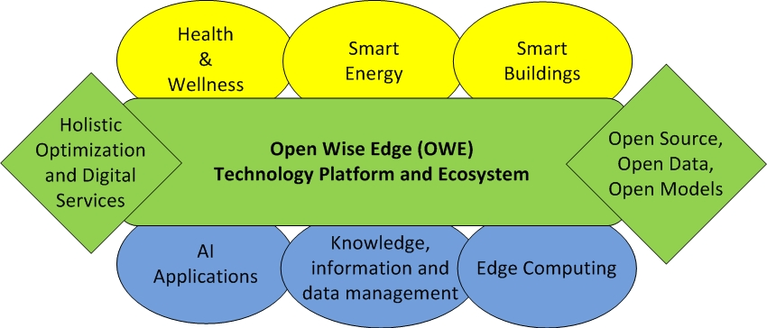
Project idea description
R&D of technology platform and ecosystem for co-innovating new AI and Edge computing enabled digital services for Health & Well-being, Smart Energy and Smart Buildings application domains
  Near real-time sensing-analysis-actuation loops
  Better responsiveness and locality
  Enhanced safety and privacy

Slide 5
Key selling points
Holistic optimization of behavior/operations/processes via AI and Edge Computing based digital services
  Health and well-being of people, sustainability, safety and productivity
  Use cases/scenarios (for international collaboration):
    Remote monitoring/caretaking(elderly people)
    Energy demand and production prediction with AI, demand-flexibility markets and control
    Smart facility management
    Other use cases?
Open Wise Edge (OWE) technology platform and ecosystem
  Open technology platform enabling digital services development with AI and Edge Computing capabilities
  Open application, model and data markets for co-innovating AI and Edge computing based digital services
Value co-creation via new digital services, value from data via AI applications

Slide 6
Partners & expertise
Partners involved
  FIN: VTT, Nokia, Empower, GMI,+ ?
    Smart Energy/Buildings
  ESP: Aunia(Subcontractor), Concatel, Keyland, TYP
    Smart Buildings/Smart Facility Management, E-health
  FR: Institut Mines Telecom (IMT), Montimage (SME), Softeam (IND), Kompai Robotics (SME), AKKA Technologies (IND) + ICAM (RES)
    Smart Building, e-health
  TUR: Erste(SME), Argedor (SME), Logosoft (IND), KocSistem (IND), T2Software (SME), METU or Bilkent
    Smart Buildings
  PRT: Polytechnic Institute of Porto, Physiosensing
    Health & Wellness-remote monitoring of elderly people
  SWE: Inoviagroup, Mälardalen Univ., Halmstad Univ., Stockholm Univ., LuminGo, Brighter, Limni, Raytelligence, Tele2
    Remote health monitoring, Smart Energy
  NLD: TNO + ?
    Smart Energy, Smart Venues
Missing partners / expertise
  Depending on national funding requirements in each country & use cases

Slide 7
More detailed collaborative R&D topics identified
AI Model management architecture @ Edge
  Provisioning architecture of models for inference and continuous learning
  Error data collection, Transfer learning
  Model validation & tracking / blockchain
Edge computing
  Different edge computing architectures and administrative domains
    Resources and QoS management, data flows, data sharing and data ownership
  Cyberphysical transaction tracking & blockchain in digital services
    Tracking physical actions/tasks, tracking control and automation actions

Slide 8
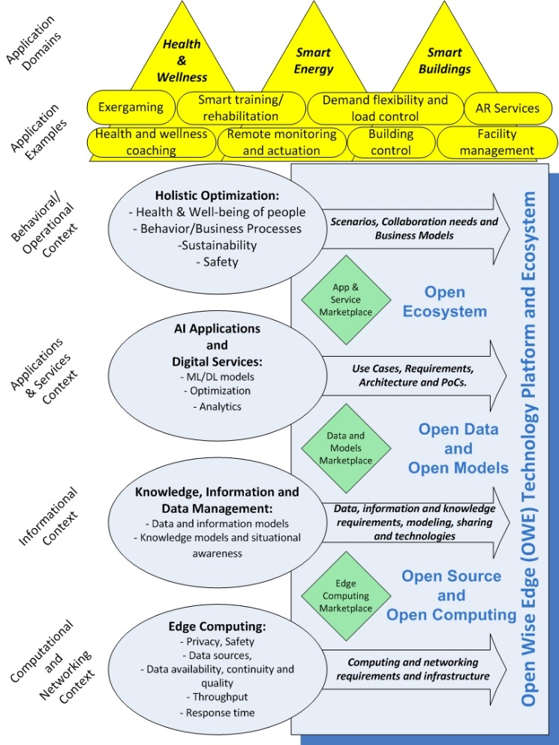
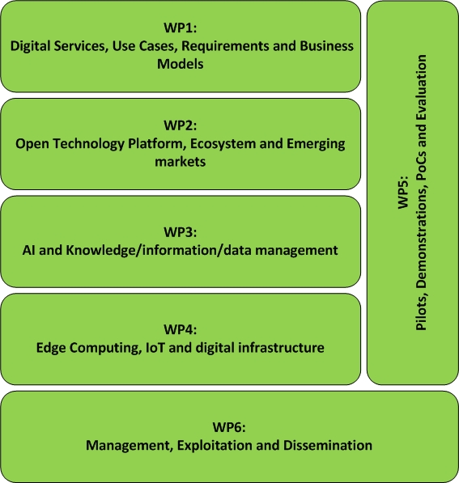
Project Organization

Slide 9
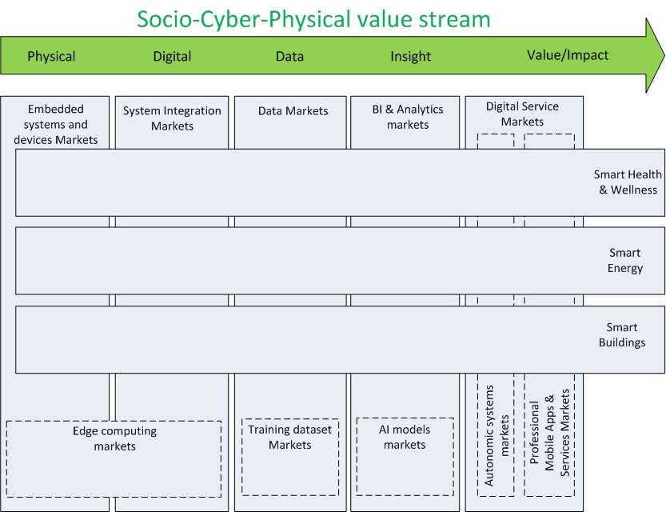
Value Stream, Value Chains and Related Markets
Social
(Smart Communities & Digitalization)
Physical
(Sensing and actuation)
Cyber

Slide 10
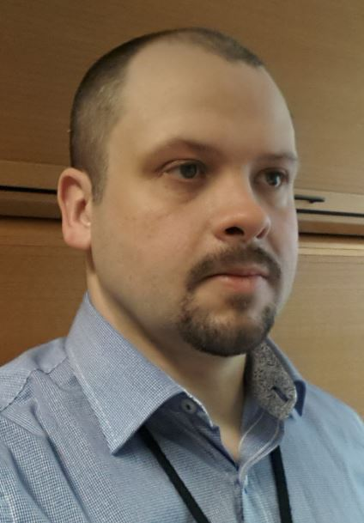
Contact details
Daniel Pakkala
VTT Technical Research Centre of Finland ltd.
daniel.pakkala@vtt.fi
+358 40 587 6261

